Slide 1


LEGAL ASPECTS OF BUSINESS • GROUP D9
THE GUARANTEE GAME
Guarantee vs. Indemnity, on Trial
Catalyst Business Finance Ltd v/s
Very Tangy Television Ltd, Richard Tuckwell, Very Tangy Media Ltd [2018] EWHC 1669 (QB)
Source: https://catalyst-finance.co.uk/
Source: www.verytangytv.com

Slide 2
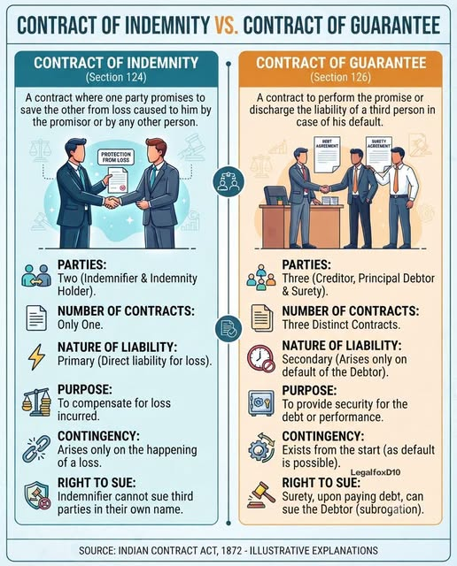
THE CORE LEGAL QUESTION
Source: Indian Contract Act 1872

Slide 3


The Set-Up
Richard Tuckwell ran Very Tangy Television Ltd (VTTL)
Needed US$40M from Vanguard Equity Fund to expand
Vanguard Equity Fund
REQUIRE UPFRONT SPEND (to meet conditions and Standards)
Short Loan for a Long Loan
Approaches Catalyst Business Finance Ltd for a short-term bridge loan
£500,000
Source: https://www.vecteezy.com/free-vector/businessman-cartoon
Source: https://corporate.vanguard.com/

Slide 4
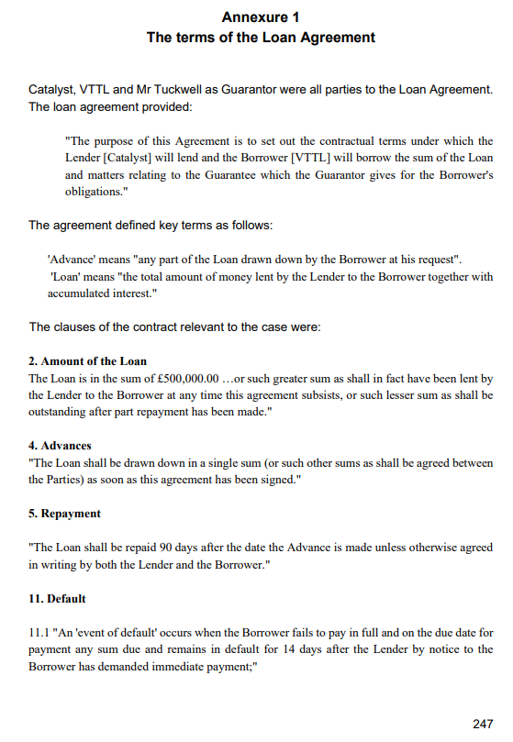
The Money Trail
Catalyst's price of entry: Tuckwell personally guarantees the loan and the house he lives in
£500,000
Promised
£80,000
Paid
Guarantee signed;
House on the line
27–29 May
2015
£0
Tuckwell begs; Catalyst wires part-payment
29 May
2015
£50,000
Vanguard pulls out; Catalyst goes quiet; then pays once more with MoU
£30,000
Jul-Aug
2015
Catalyst demands repayment
10 May
2016
VTTL defaults
£0

Slide 5

Two Weeks Later

Slide 6
The Money Trail
Catalyst's price of entry: Tuckwell personally guarantees the loan and the house he lives in
£500,000
Promised
£80,000
Paid
Guarantee signed;
House on the line
27–29 May
2015
£0
Tuckwell begs; Catalyst wires part-payment
29 May
2015
£50,000
Vanguard pulls out; Catalyst goes quiet; then pays once more with MoU
£30,000
Jul-Aug
2015
Catalyst demands repayment
10 May
2016
VTTL defaults
£0

Slide 7


Slide 8

VTTL’s Response
Catalyst is in Breach of Contract
They promised £500,000 in the loan agreement yet disbursed only £80,000.
I am Payable only after receiving £500,000 in total!
So, I claim £7.6 million in damages
Why should I pay back! Lol!!
My Liability is only Secondary
It comes into picture only when VTTL defaults.
Here Catalyst have made the breach of contract!
So NO PERSONAL Liability
Source: www.pinterest.com/pin/homer-simpson-backs-into-the-bushes

Slide 9
Court’s Observation
Catalyst did not Breach the Contract
Tuckwell Has Primary Liability
There is no other circumstance for Catalyst to transfer the sum to VTTL
+
Boards’ approval requirement was previously communicated with VTTL
Contract of Suretyship explained from the case: VOSSLOH V ALPHA TRAINS [2010] EWHC 2443
Tuckwell's Personal Guarantee landed here — tipped toward PRIMARY
CLASSIC GUARANTEE
HYBRID ZONE
(Tuckwell's guarantee)
PERFORMANCE / DEMAND BOND
purely Secondary
pay on mere demand
some secondary, some primary

Slide 10
THE VERDICT
Judgment for Catalyst
Tuckwell's Personal Guarantee was a hybrid document — but on the point that mattered, it created primary liability
The principle of co-extensiveness did not apply, so he could not borrow VTTL's defences
£80,000 +interest +legal costs
Recovered personally from Tuckwell
“I shall be liable under this deed in every respect as a principal debtor.”

Slide 11
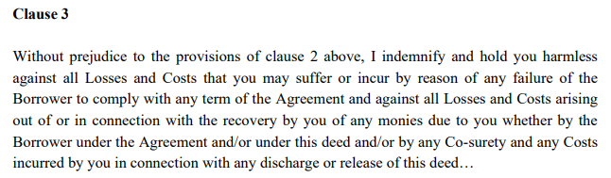
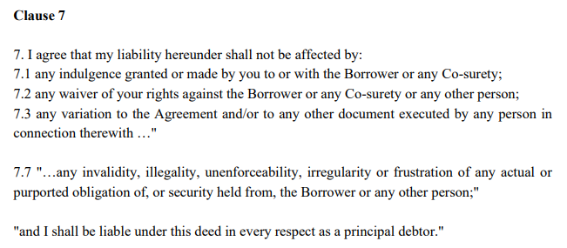
CONSTRUING TUCKWELL'S PERSONAL GUARANTEE
Clues That Sealed His Fate
1
Clause 3
2
Clause 7.7

Slide 12
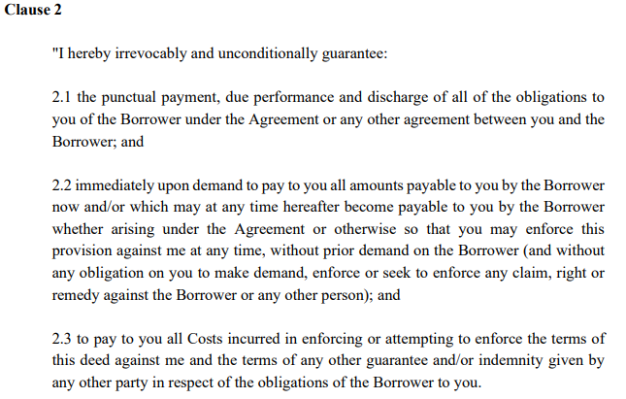
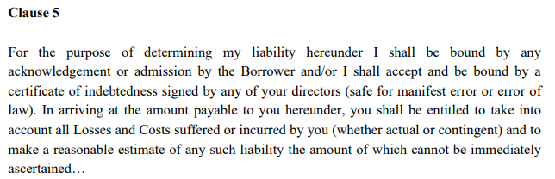
CONSTRUING TUCKWELL'S PERSONAL GUARANTEE
Clues That Sealed His Fate
3
Clause 2
4
Clause 5

Slide 13
BRINGING IT HOME
Key Takeaways
A document titled 'Guarantee' isn't always one in substance — courts read the actual wording, not the label
'Principal debtor' and 'indemnify and hold harmless' are drafting fingerprints of primary liability
1
2
3
4
Guarantee = secondary & co-extensive; Indemnity = primary & independent
Read every clause (especially the quiet ones at the end) before you put your house on the line

Slide 14
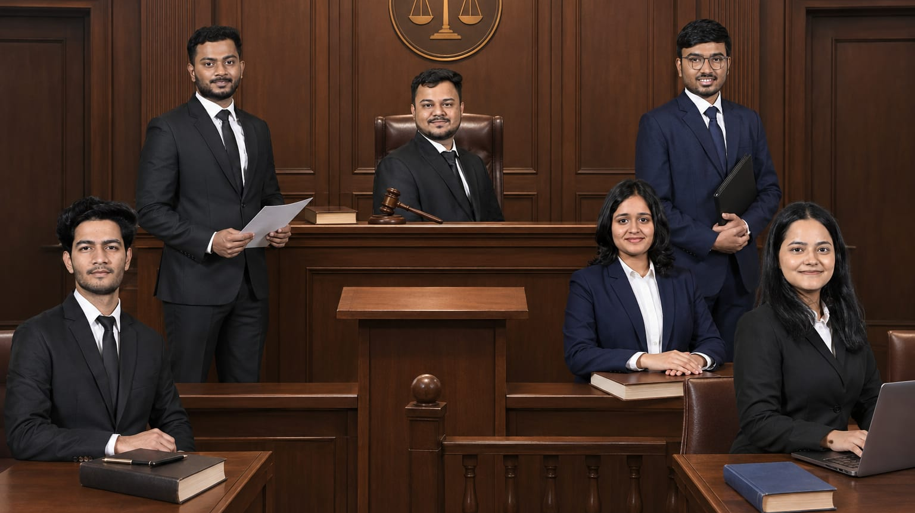
Kaushik
Atharva
Midhun
Maitreyi
Rishabh
Manvi

